Slide 1
Normative accounts of Probability Weighting in Decision Science Benjamin Skjold
Involved researchers & personnel
Ollie Hulme, DRCMR, Supervisor
Tobias Andersen, DTU, Supervisor
Project Leader
Ollie Hulme

Slide 2
Background & Motivation
Probability weighting – what is it?
Concept introduced with Prospect Theory ((Kahneman and Tversky (1979, 1992))
Non-linear function transforming objective probabilities into people's internal representation of the probability.
Response to examples where expected utility could not explain the general behavior
E.g:
Choice 1: | A. $300 for sure | Vs. | B. $400 with 80% probability
Choice 2: | C. $300 with 25% probability | Vs. | D. $400 with 20% probability

Slide 3
Background & Motivation
Probability weighting – what is it?
Concept introduced with Prospect Theory ((Kahneman and Tversky (1979, 1992))
Non-linear function transforming objective probabilities into people's internal representation of the probability.
Response to examples where expected utility could not explain the general behavior
E.g:
Choice 1: | A. $300 for sure | Vs. | B. $400 with 80% probability
Choice 2: | C. $300 with 25% probability | Vs. | D. $400 with 20% probability

Slide 4
Background & Motivation
Probability weighting – what is it?
Concept introduced with Prospect Theory ((Kahneman and Tversky (1979, 1992))
Non-linear function transforming objective probabilities into people's internal representation of the probability.
Response to examples where expected utility could not explain the general behavior
E.g:
Choice 1: | A. $300 for sure | Vs. | B. $400 with 80% probability
Choice 2: | C. $300 with 25% probability | Vs. | D. $400 with 20% probability

Slide 5
Background & Motivation
Probability weighting – what is it?
Concept introduced with Prospect Theory ((Kahneman and Tversky (1979, 1992))
Non-linear function transforming objective probabilities into people's internal representation of the probability.
Response to examples where expected utility could not explain the general behavior
E.g:
Choice 1: | A. $300 for sure | Vs. | B. $400 with 80% probability
Choice 2: | C. $300 with 25% probability | Vs. | D. $400 with 20% probability

Slide 6
Background & Motivation
Probability weighting – what is it?
Concept introduced with Prospect Theory ((Kahneman and Tversky (1979, 1992))
Non-linear function transforming objective probabilities into people's internal representation of the probability.
Response to examples where expected utility could not explain the general behavior
E.g:
Choice 1: | A. $300 for sure | Vs. | B. $400 with 80% probability
Choice 2: | C. $300 with 25% probability | Vs. | D. $400 with 20% probability

Slide 7
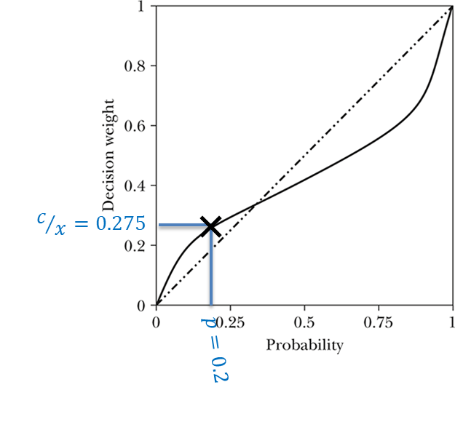
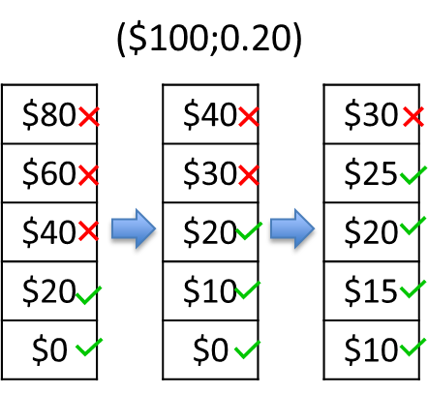
Background & Motivation
Probability weighting – experiments
Decisions from description
Outcome x with probability p
c = 27,5
x = 100
p = 0.2

Slide 8
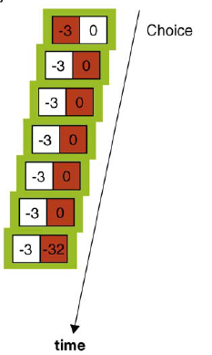
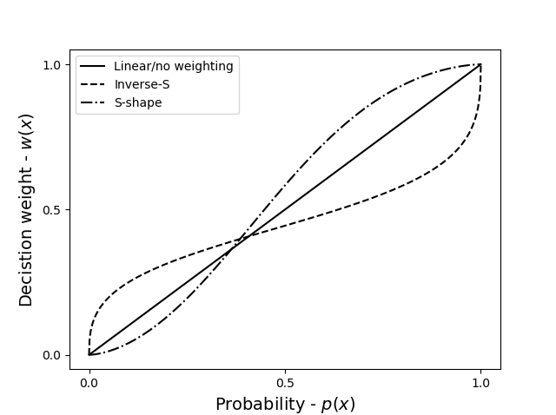
Background & Motivation
Probability weighting – experiments
Decisions from experience
Probabilities and outcomes are not given a priori, but must be learned
Disagreement in the field on the shape
Description-experience gab

Slide 9
Background & Motivation
Probability weighting – why does it exist?
Traditionally probability weighting has been considered an irrational bias
Descriptive Theories; i.e. relating to actual (observed) rather than optimal (predicted) behavior
Very recently researchers have released normative accounts of probability weighting; i.e. theories that explain why probability weighting should exist
Few different approaches have been presented; I focus one from Kirstein et al. (2020)

Slide 10
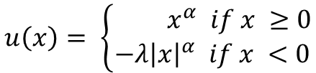


Background & Motivation
CPT-Model
Descriptive model based on expected value
$$\tilde{EU}=Σu(x_{i})w\left(p_{i}\right)$$
Valuefunction
Weightingfunction
$$u\left(x\right)= \left\{\begin{aligned}{ x}^{α} if x ≥0 \\ −λ{\left|x\right|}^{α} if x <0\end{aligned}\right.$$
$$w\left(p\right)= \frac{δp^{γ}}{δp^{γ}+{(1−p)}^{γ}}$$

Slide 11
Background & Motivation
CPT-Model
Descriptive model based on expected value
$$\tilde{EU}=Σu(x_{i})w\left(p_{i}\right)$$
Weightingfunction
$$w\left(p\right)= \frac{δp^{γ}}{δp^{γ}+{(1−p)}^{γ}}$$

Slide 12


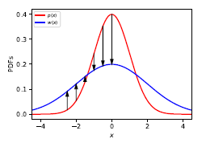
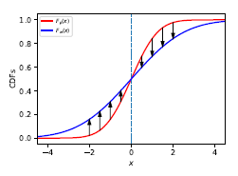
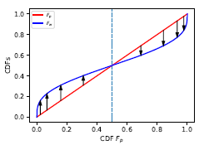
Background & Motivation
LML-Model
“[...] Probability weighting means that a decision maker has greater uncertainty about the world than the observer.”
Illustrated by example with gaussian noise
Same approximation of p, but decision maker is more
uncertain than the observer

Slide 13
Background & Motivation
LML-Model
“[...] Probability weighting means that a decision maker has greater uncertainty about the world than the observer.”
Illustrated by example with gaussian noise
Same approximation of p, but decision maker is more
uncertain than the observer

Slide 14
Background & Motivation
LML-Model
“[...] Probability weighting means that a decision maker has greater uncertainty about the world than the observer.”
Illustrated by example with gaussian noise
Same approximation of p, but decision maker is more
uncertain than the observer

Slide 15
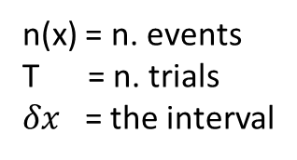
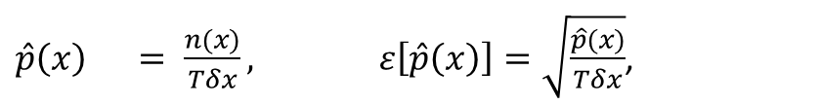
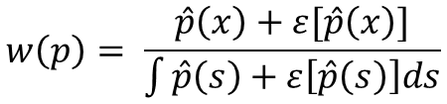
Background & Motivation
LML-Model
Estimation errors for probabilities – decisions from experience
$$w\left(p\right)= \frac{\hat{p}\left(x\right)+ε[\hat{p}\left(x\right)]}{\int{\hat{p}\left(s\right)+ε\left[\hat{p}\left(s\right)\right]ds}}$$
$\hat{p}\left(x\right) = \frac{n(x)}{Tδx}, ε\left[\hat{p}\left(x\right)\right]=\sqrt{\frac{\hat{p}(x)}{Tδx}}$,
n(x) = n. events
T = n. trials
$δx$ = the interval

Slide 16
Aims
Survey the literature on descriptive and normative models of probability weighting
Design experiments that discriminate between the prospect theory and the LML model
Test via simulation
Set up analysis pipelines that can analyse data under these experiments
Explore new phenomena predicted under these models

Slide 17
Experimental strategy
Formalizing the LML model (normative) and PT model (descriptive) as graphical models
Evaluate qualitatively potential differences in predictions
Formalize as experiments via graphical models that could reveal differences
Simulate different synthetic agents behaving according to these different models, and evaluate disagreements between the models
Iterating between experimental design and simulations

Slide 18
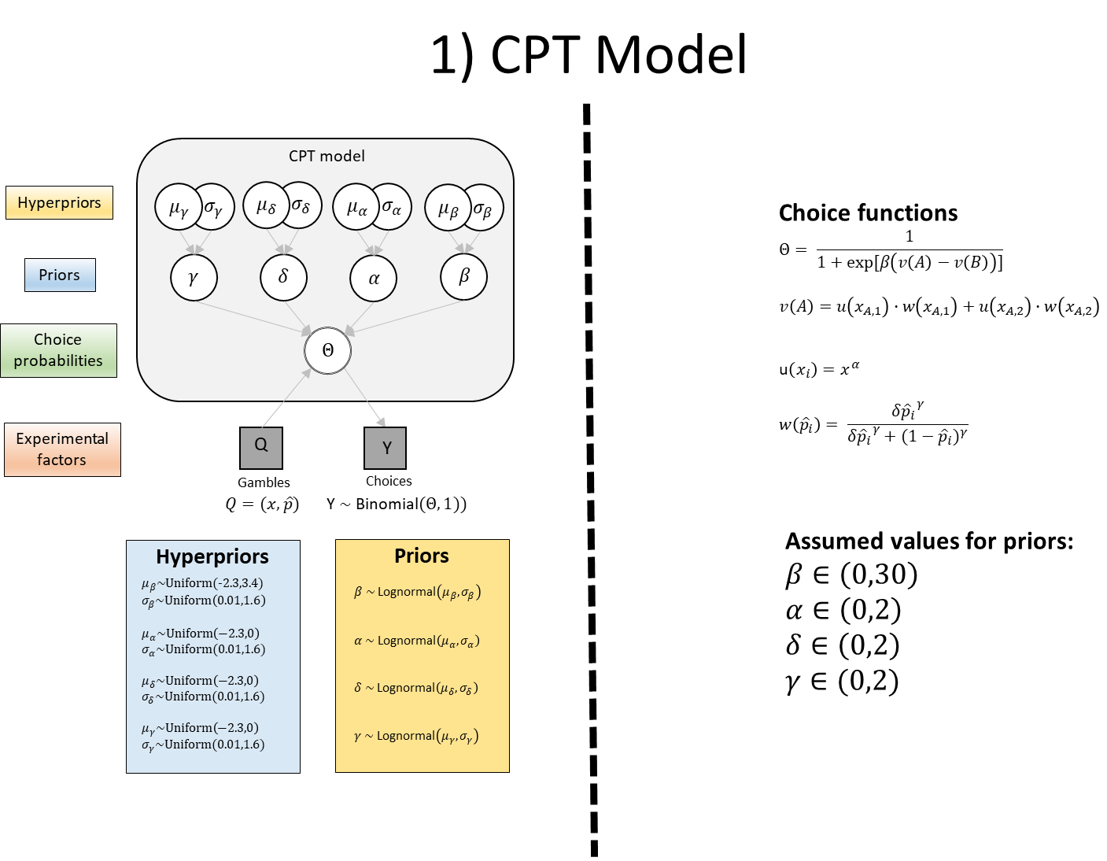
Models

Slide 19
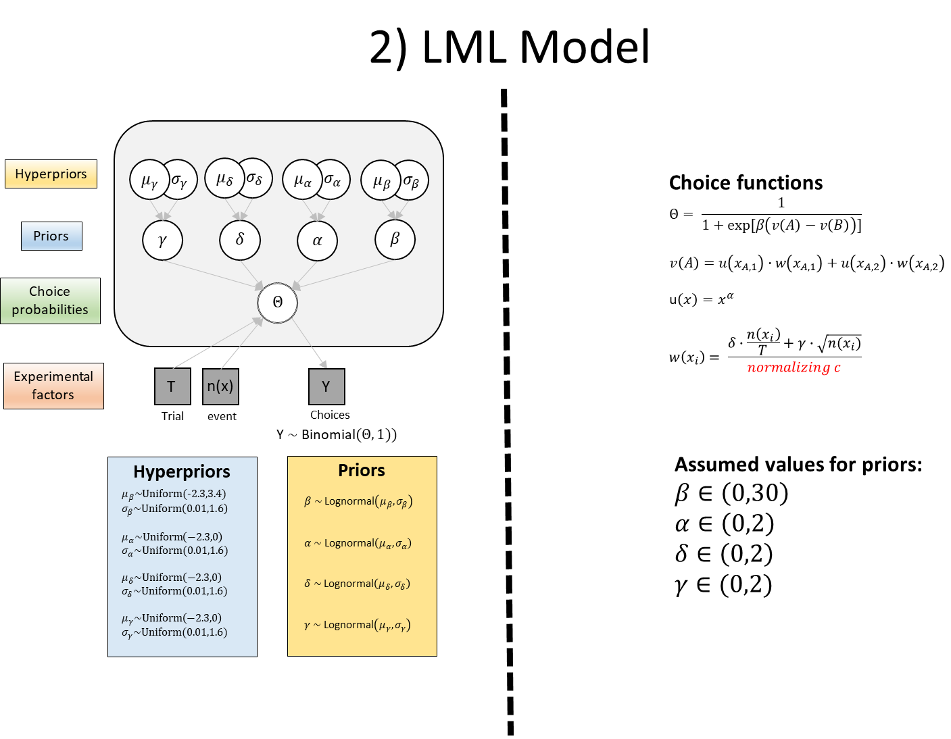

Models
$$\frac{n(x_{i})}{T^{2}}$$

Slide 20






Experimental Design
Experiment will be conducted using synthetic agents representing each model
Decisions from experience (Full feedback paradigm)
Example below: A = ($4,1.0), B = ($9,0.2)
A
4
A
4
A
4
A
4
B
0
B
0
B
9
B
0
…
Gamble 1, #1
Gamble 1, #2
Gamble 1, #3
Gamble 1, #n
Before Choosing
After choosing
Before Choosing
After choosing
Before Choosing
After choosing
Before Choosing
After choosing
Parameter estimation
$$\hat{p}\left(x\right) = τ\frac{n(x)}{Tδx}$$
$$ε\left[\hat{p}\left(x\right)\right]=γ\sqrt{\frac{\hat{p}(x)}{Tδx}}$$
$$\hat{p}\left(x\right) = τ\frac{n(x)}{Tδx}$$
$$ε\left[\hat{p}\left(x\right)\right]=γ\sqrt{\frac{\hat{p}(x)}{Tδx}}$$
$$\hat{p}\left(x\right) = τ\frac{n(x)}{Tδx}$$
$$ε\left[\hat{p}\left(x\right)\right]=γ\sqrt{\frac{\hat{p}(x)}{Tδx}}$$
…
$$\hat{p}\left(x\right) = τ\frac{n(x)}{Tδx}$$
$$ε\left[\hat{p}\left(x\right)\right]=γ\sqrt{\frac{\hat{p}(x)}{Tδx}}$$
LML model
PT model
…
$$Q=(x,\hat{p})$$
$$Q=(x,\hat{p})$$
$$Q=(x,\hat{p})$$
$$Q=(x,\hat{p})$$

Slide 21
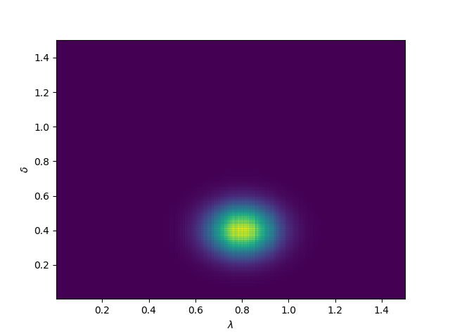
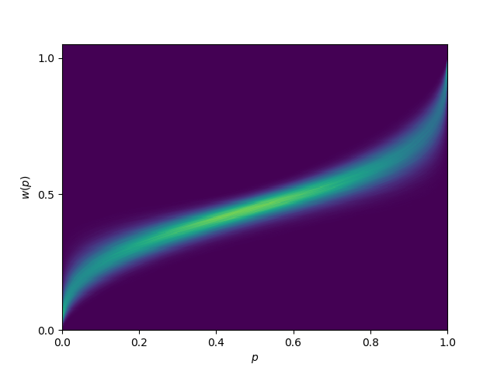
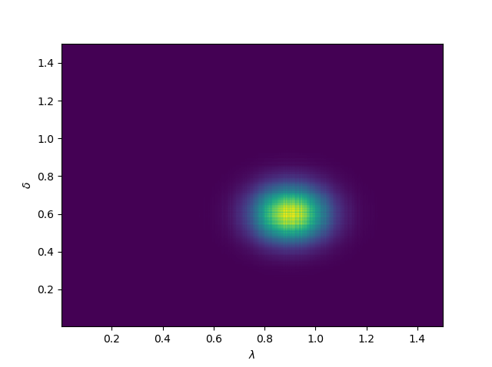
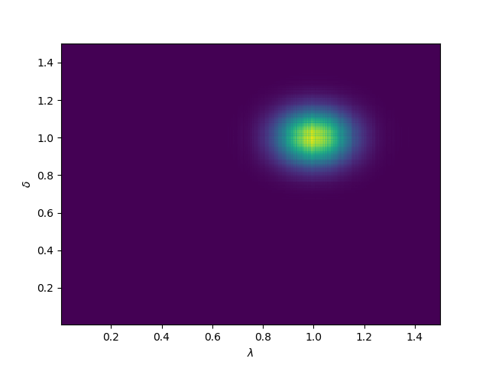
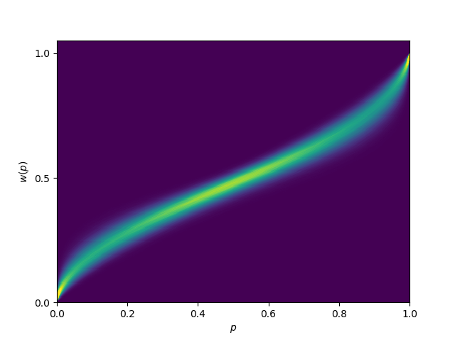
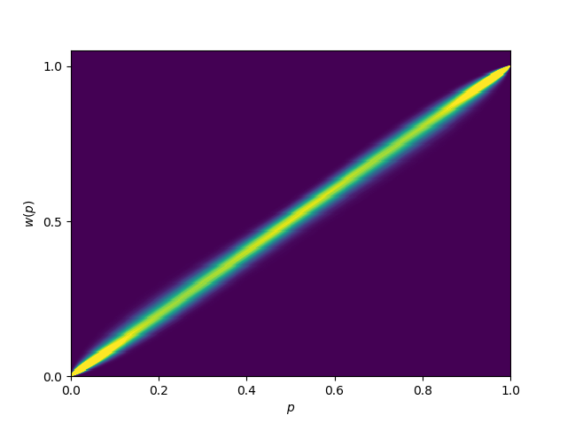

Predictors
$$w\left(\hat{p}\right)= \frac{{δ\hat{p}}^{γ}}{{δ\hat{p}}^{γ}+{(1−\hat{p})}^{γ}}$$
PT model
Parameter estimates
Weighting function
LML model
Parameter estimates
Weighting function
#1
#2
#n
Stable parameter
Stable weighting function
Dynamic parameter
Dynamic weighting function
…
…
…
…

Slide 22
Planned Data Analyses
Based on the data from the simulations (using synthetic agents):
Using Bayesian Model Comparison
Comparing the models on basis of
Bayes Factor
Posterior model probabilities
(Protected) exceedance probabilities
Qualitatively evaluating the results to update the simulations with the aim of exposing differences

Slide 23
Status & Publications
Status
Literature survey 90 % complete
Initial models formulated (more might be added)
Next step: Initial simulations – initial experiments are formulated
Comparing normative and descriptive models of probability weighting (Skjold, Andersen, Hulme)
This could be used as the basis for a neuroimaging experiment aiming to map the cortical representation of probability, and how this is distorted under different settings.
Publications
Future work

